Slide 1
CAPSTONE PROJECT
Medical Inventory System and Infrastructure

Slide 2
DESIGNING AND IMPLEMENTING A NETWORK

Slide 3
Objective of the Project
To reduce cost
To reduce lag
To access the records at ease
To make the records more secure

Slide 4
DESIGN CRITERIA
There should be Three Departments and all departments are interconnected
Only Two Departments are connected to internet
It has One WebServer & One Database
It should have an Firewall

Slide 5
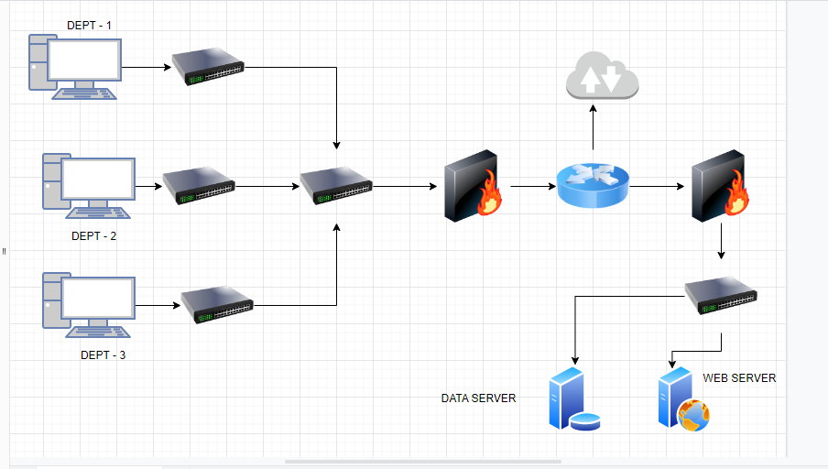
DESIGN IMAGE.IO

Slide 6
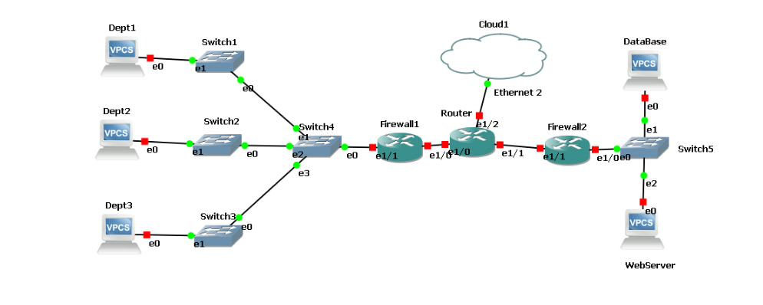
DESIGN GNS3

Slide 7
DEVICES USED
SWITCH: Switches are networking devices .They connect devices in a network and use packet switching to send, receive or forward data packets or data frames over the network. A switch has many ports, to which computers are plugged in.
ROUTER: A router is a device that connects two or more packet-switched networks or subnetworks.
FIREWALL: A Firewall is a network security device that monitors and filters incoming and outgoing network traffic based on an organization's previously established security policies.
WEB-SERVER: A web server is a computer that stores web server software and a website's component files. A web server connects to the Internet and supports physical data interchange with other devices connected to the web.
DATABASE: A database organized according to ownership of records, allowing records to have multiple owners and thus providing multiple access paths to the data.

Slide 8
IP Implementation
DEPT-1: 192.168.1.0 255.255.255.0
DEPT-2: 192.168.2.0 255.255.255.0
DEPT-3: 192.168.3.0 255.255.255.0
DATABASE: 192.168.4.0 255.255.255.0
WEB-SERVER: 192.168.4.0 255.255.255.0

Slide 9
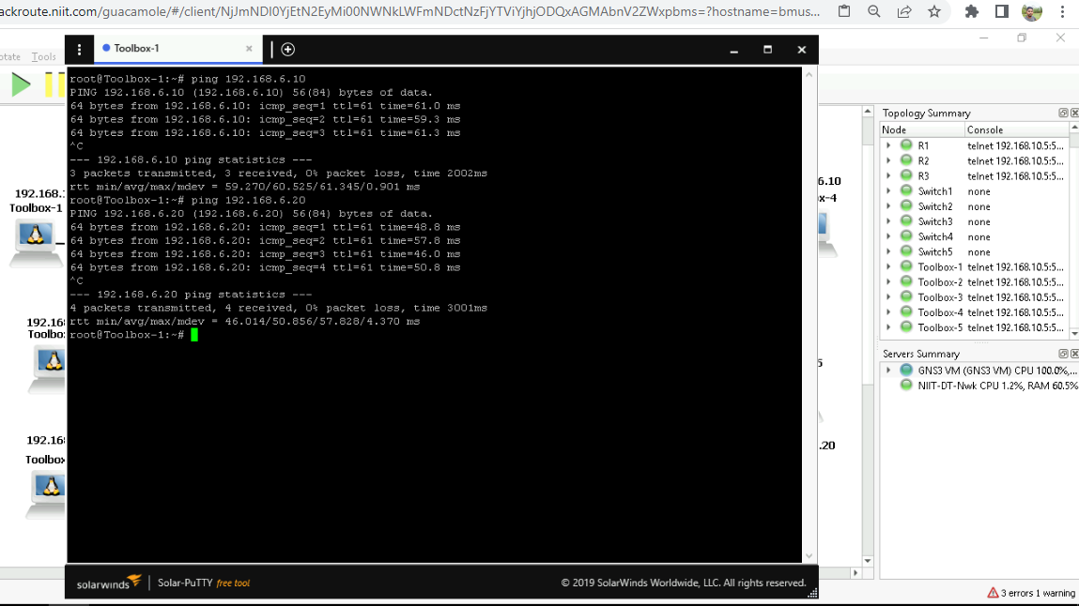

Slide 10
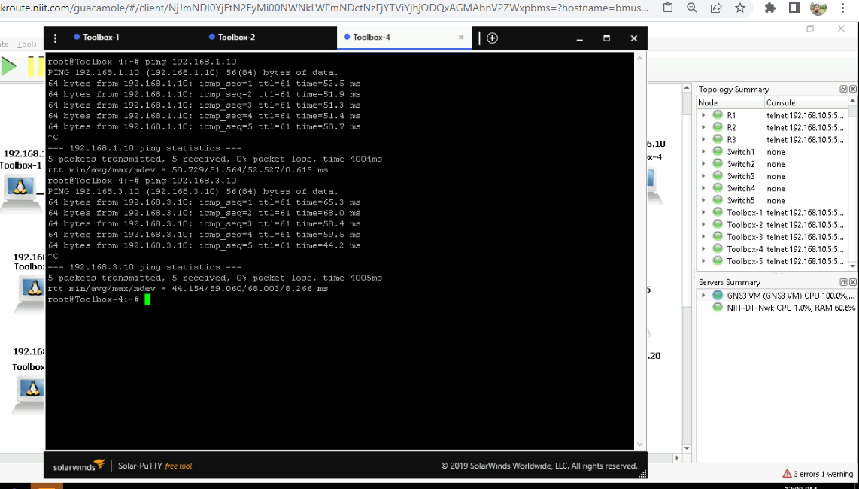

Slide 11
CHALLENGES
To implement Router RIP on routers
To implement Internet connectivity
To implement ACL on routers
To keep the CPU Utilization under control

Slide 12
SECURITY SERVICES AND SYSTEM SERVICES SET-UP

Slide 13
CONTENTS
Implementing snorts on web-server
Implementing apache2 on web-server
Implementing MYSQL on Database
Implementing Kerberos
To create User

Slide 14
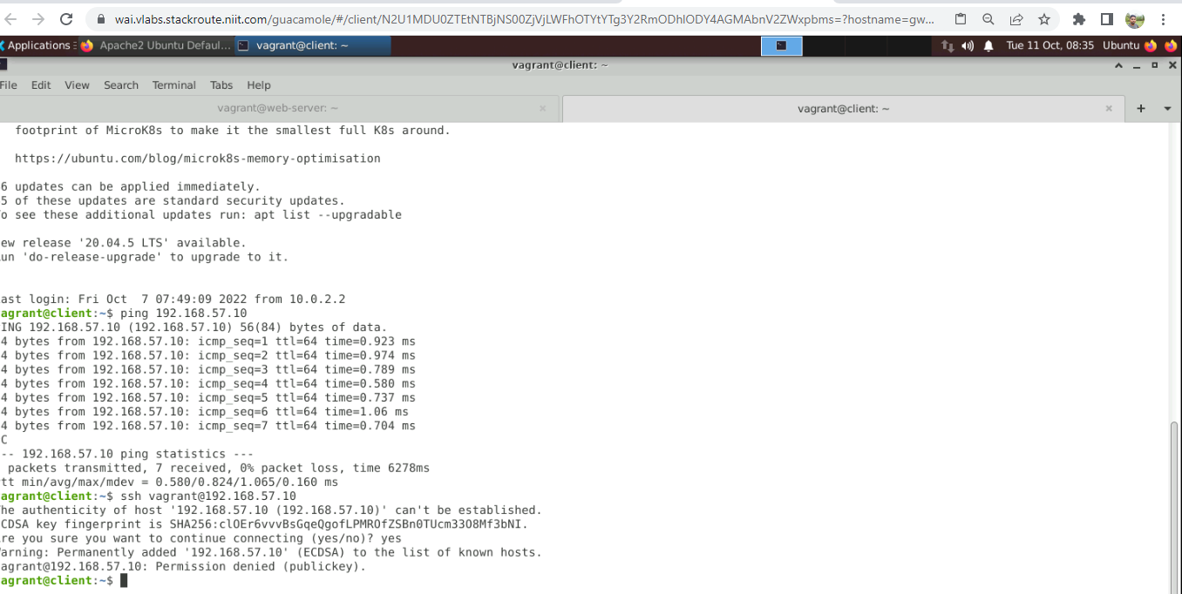
SNORT

Slide 15
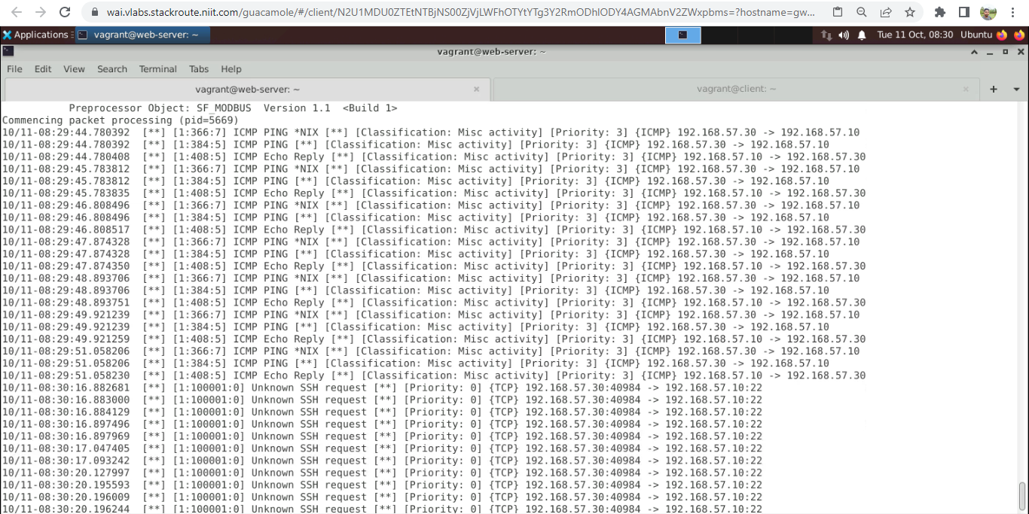

Slide 16
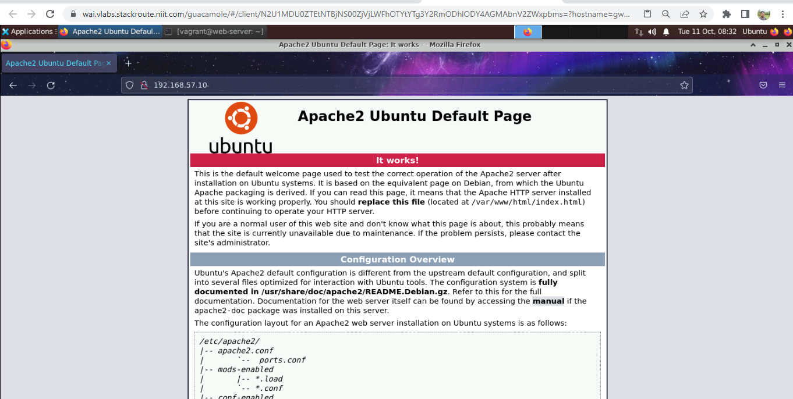
APACHE2

Slide 17
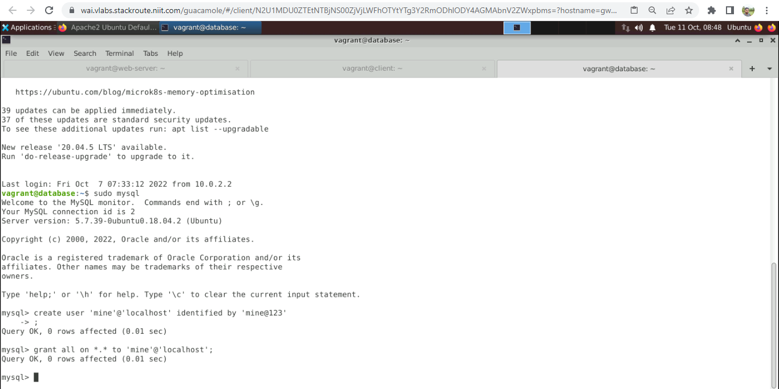
MYSQL

Slide 18
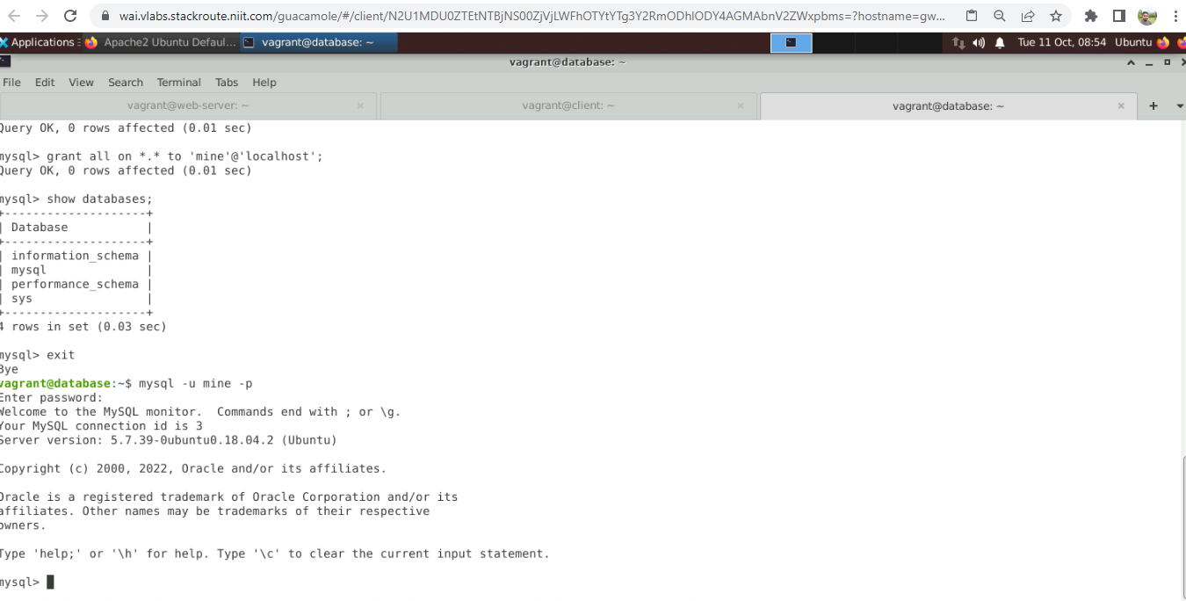

Slide 19
THANK YOU

